Slide 1
ReactJS vs. Angular

Slide 2
REACT JS
What Is It?
An open-source JavaScript Library for building fast and interactive user interfaces for web and mobile applications.
What Is Its Primary Use?
It is primarily used for building user interfaces for web and mobile applications.
Why Is It So Popular?
It uses virtual DOM which gives developers increased flexibility and improved performance.
How Soon Can I Learn To Use It?
The average time is anywhere between 1-6 months. If someone spends a few hours each day, they will be able to master it within few months. Having prior knowledge and experience reduces the time it will take.
Notes:
1. REACT JS is a one of the front-end javascript libraries available for web development created by facebook
2. It is useful in building user interface components
3.

Slide 3
Upsides and Downsides
Upsides
Downsides
Use of Virtual DOM improves performance and leads to faster rendering
Increased reusability of code as the interface is divided into small components
Use of JavaScript Syntax Extension (JSX) allows to embed HTML structure into the JavaScript file
One-way Data Binding gives developers better control of whole application
Only implements the view component of the MVC
JSX is a learning curve due to its complexity with larger applications
Poor documentation due to accelerated growth
Developers face difficulty with adopting and keeping up with new aspects of the technology as it grows at a rapid pace

Slide 4



Getting Started With React (using Create React App)
NodeJS
Create React App
Text Editor of Choice
Create React App requires Node.js >= version 14.0.0 and npm >= 5.6
Create React App can be used to give you everything you need to create a React application in one command and dependency
I will be using VSCode!
Plus a familiarity with HTML, CSS, and JavaScript!
Notes:
While you can create a react application with just a simple script tag in HTML, the most common and easiest way is to use Create React App. Create React App automatically installs React, Babel, and Webpack so that all the necessary dependencies are included.
It required Node.js 14.0.0 or later and npm 5.6 or later, and then you can just use 'npx create-react-app <appname>' to create an app in the folder you specify.
Then, you can just use your favorite editor, such as VSCode, to actually create the app. This is where you'll need an understanding of JavaScript and HTML to manipulate the DOM, and CSS to style it.

Slide 5
"Hello World" Demo in React
Notes:
Let's go over creating a simple "Hello World" app in React.
First, open the parent folder for where you want your React app to be in a terminal, such as the one provided by VSCode. Then run "npx create-react-app <appname>", here, this will take a few minutes so to save time I have done this already with npx create-react-app demo which created a react app in a folder called demo.
If I run npm start, you'll see that I get a demo page, but let's try to create a component to say hello world. So I'll define a function called Hello(), and make it return a JSX object containing a div with an h1 header saying "Hello World!", and a paragraph giving the result of the expression {1+1} using curly braces
Then I'll replace this demo code in the App() function, where the app runs, and make it just include a Hello component. Then I'll save it and refresh my browser, and viola, Hello World!
If you'd like a more in-depth demo, we've provided one in the handout pdf!

Slide 6
Angular
What Is It?
A Typescript-based open-source framework for building client-side web applications
Why Is It So Popular?
It allows developers to separate the web application's logic from manipulating DOMs.
What Is Its Primary Use?
It is primarily used to develop dynamic Single Page Applications (SPAs). It provides a framework and structured environment for developers to design and program.
How Soon Can I Learn To Use It?
Assuming you are brand-new, the consensus is about 2-3 months to become a function developer with Angular. However, if you're already familiar with web development and Typescript, it will likely take less!

Slide 7
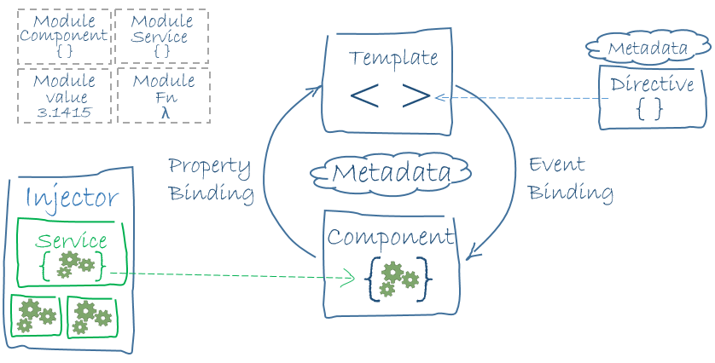

Angular Architecture Analogy
Application: the apartment building
Modules: the apartments in the building
Components: the rooms inside an apartment
Services: elevators and stairs in the building
Pipes: electrical wiring
SharedModules: swimming pool, gym, tennis court, etc.

Slide 8
Upsides and Downsides
Upsides
Downsides
Implements a Model-View-Controller architecture, which many developers (including us!) are familiar with
Custom directives to make an application more dynamic
Modules makes the code more maintainable and easier to digest and understand
Uses Typescript, which is essentially Javascript with static typing (so it can check for structural bugs)
Very steep learning curve
Many different versions, including a total rework from the first to second version
Limited Search Engine Optimization capabilities, meaning your webpage will show up less when someone searches Google
Migrating to Angular is difficult due to the differences in structure between Angular applications and other framework applications

Slide 9

Getting Started With Angular
NodeJS
Angular CLI
Text Editor of Choice
Angular requires an active LTS or maintenance LTS version of Node.js.
You use the Angular CLI to create projects, generate application and library code, and perform a variety of ongoing development tasks such as testing, bundling, and deployment.
I will be using VSCode!
Plus a familiarity with HTML, CSS, and JavaScript!

Slide 10
"Hello World" Demo in Angular

Slide 11
React vs Angular: Similarities
Both are open source
Both are popular and used for web development around the world
Both implement and use the idea of "components"
Both also maintain a concept of a component's "state"
Both were developed and are maintained by large tech companies for their applications (Facebook for React and Google for Angular)

Slide 12
React vs Angular: Differences
React is a JS library for views, whereas Angular is a MVC complete framework
React uses a virtual DOM, Angular uses a real DOM
React is written in JavaScript, Angular is written in Typescript
Angular has a steeper learning curve than React
React is harder to set up but can be used to deliver products quickly, while Angular is easier to set up but can lead to product delays due to coding errors.

Slide 13
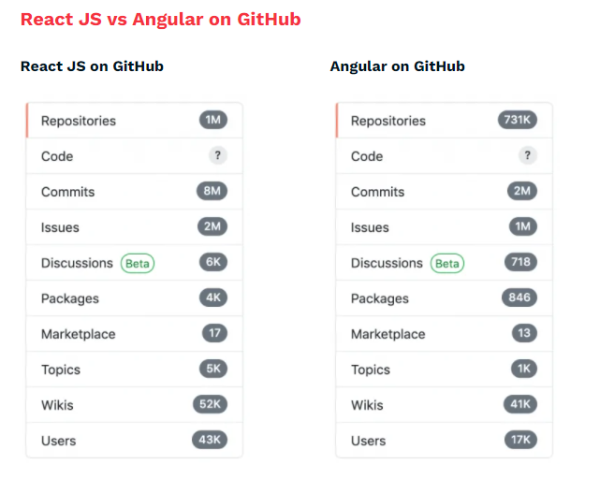
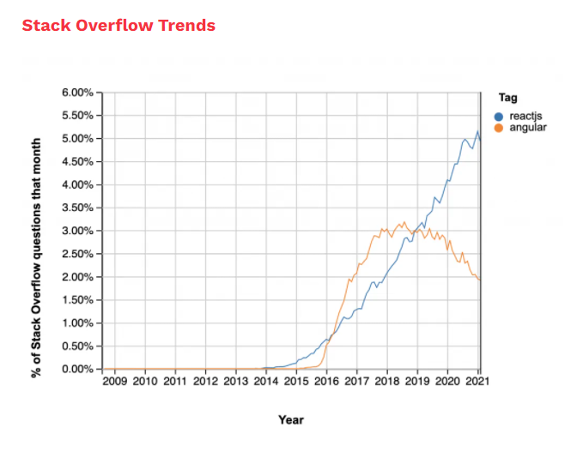
Notes:
Here we have a comparison of Angular versus React in terms of popularity. Angular used to be more popular than React, but as you can see in the chart, in recent years React has pulled ahead and become the most popular of the two frameworks, with over 1 million repositories on Github, but only about 700,000 for Angular.

Slide 14
Sources
Angular
https://www.edureka.co/blog/angular-tutorial/
https://www.andolasoft.com/blog/why-angular-is-so-popular-in-modern-application-development.html
https://www.dotnettricks.com/learn/angular/How-long-will-it-take-to-learn-Angular
https://www.doodleish.com/2021/01/time-to-learn-angular.html#:~:text=So%2C%20for%20learning%20the%20basics,you%20a%20year%20or%20more.
https://www.edureka.co/blog/advantages-and-disadvantages-of-angular/
https://www.knowledgehut.com/blog/web-development/advantages-and-disadvantages-of-angular
https://cupofcode.medium.com/the-main-building-blocks-of-an-angular-application-explained-cup-of-angular-part-1-dce71c88d449
https://www.youtube.com/watch?v=TC1oVXlVE3M
https://angular.io/guide/setup-local
https://www.guru99.com/react-vs-angular-key-difference.html
React
https://www.w3schools.com/whatis/whatis_react.asp
https://www.ipraxa.com/blog/advantages-of-reactjs-reasons-to-use/
https://www.w3spoint.com/advantages-disadvantages-reactjs
https://www.cygnismedia.com/blog/reasons-why-react-js-is-popular/
https://blog.udemy.com/what-is-react-and-what-is-it-used-for/
https://careerkarma.com/blog/how-long-does-it-take-to-learn-react-js/
https://www.javatpoint.com/pros-and-cons-of-react
https://reactjs.org/docs/create-a-new-react-app.html
https://www.simplilearn.com/tutorials/reactjs-tutorial/what-is-reactjs

